Slide 1
Is it easy to be young?
Do you really think so?

Slide 2
Teenagers and their problems
I think that it isn’t so easy to be young. Cause teens’ face to face with a lot of difficulties & problems.
The building of personality is a complex process, you know.
During this period young people have a lot of controversy with society. Especially, with their parents or with people, who try to educate them.

Slide 3

Teenagers and their problems
I think that it isn’t so easy to be young. Cause teens’ face to face with a lot of difficulties & problems.
The building of personality is a complex process, you know.
During this period young people have a lot of controversy with society. Especially, with their parents or with people, who try to educate them.

Slide 4
The main problems
Some teens’ live in their own world
2. Education
3. Youngs can get a bad company
4. Relationships with peers
5. Misunderstanding of the adult
6. Alcohol & drugs

Slide 5
The main problems
Some teens’ live in their own world
2. Education
3. Youngs can get a bad company
4. Relationships with peers
5. Misunderstanding of the adult
6. Alcohol & drugs

Slide 6
Problem-solving.
Some teens’ live in their own world
2. Education
3. Youngs can get a bad company
4. Relationships with peers
5. Misunderstanding of the adult
6. Alcohol & drugs

Slide 7
Problem-solving.
Some teens’ live in their own world
2. Education
3. Youngs can get a bad company
4. Relationships with peers
5. Misunderstanding of the adult
6. Alcohol & drugs

Slide 8


Some teens’ live in their own world
I mean, some teenagers are very self-contained. It makes them suffer. And they really need the help of adults and peers.
How we can help :
1. Adults should be more careful
2. You shouldn’t swear. Total can be achieved with tenderness and love.
3. Peers don’t have to be aggressive.

Slide 9
Problem-solving.
Some teens’ live in their own world
2. Education
3. Youngs can get a bad company
4. Relationships with peers
5. Misunderstanding of the adult
6. Alcohol & drugs

Slide 10

Education
Very serious problem! It needs help of adults.
Some teens don’t realize how important it is.
How we can help :
1. Parents should explain to children how important it is.
2. Teens should understand that it is necessary only for them.
3. Adults should control children's education. But do not press them.

Slide 11
Problem-solving.
Some teens’ live in their own world
2. Education
3. Youngs can get a bad company
4. Relationships with peers
5. Misunderstanding of the adult
6. Alcohol & drugs

Slide 12
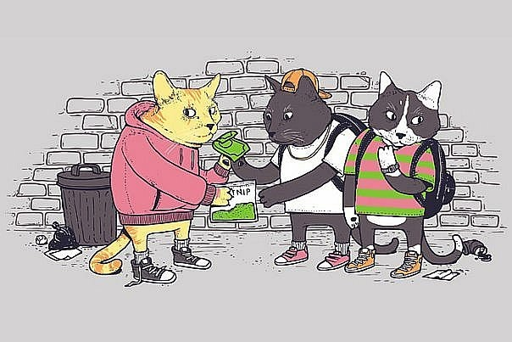
The young can get a bad company
It is important to explain to a child from early childhood that is good and what is bad.
Of course control your child from everything is impossible.
Again, an important problem.
And again, adults can help .
1. More often talk with a teenager. He must trust you.
2. Try to organize teens’ free time.
3. Spend time together. The whole family.

Slide 13
Problem-solving.
Some teens’ live in their own world
Education
Youngs can get a bad company
4. Relationships with peers
5. Misunderstanding of the adult
6. Alcohol & drugs

Slide 14


Relationships with peers
Often a teenager can't find common language with his peers.
They either can does not understand his. Or is he just is not interesting with them.
Well, don’t worry so much.
1. You can find friends among adults.
It isn’t always wine of teenager.
2. If you still can not make friends with peers, take yourself to something. (Read books, play sports, dance, draw)
3. When you get older probably the problem will be gone. Don’t worry too much.

Slide 15
The main problems
Some teens’ live in their own world
Education
Youngs can get a bad company
Relationships with peers
5. Misunderstanding of the adult
6. Alcohol & drugs

Slide 16

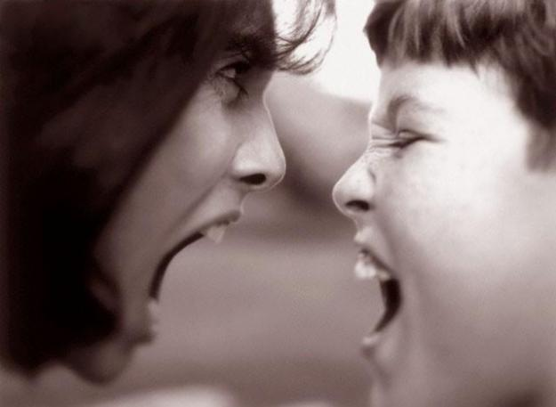
Misunderstanding of the adults
LOVE
What to do:
Because of the different generations is very difficult to find a common language.
This happens very often.
Therefore, children and adults can often swear.
Understanding
1. Be more attentive to each other.
AND
Ability to listen
2. Spend more time together.
The three most important things
3. And of course to love each other.

Slide 17
Problem-solving.
Some teens’ live in their own world
Education
Youngs can get a bad company
Relationships with peers
Misunderstanding of the adult
6. Alcohol & drugs

Slide 18


Alcohol & drugs
Parents should explain to a teenager that is very harmful.
And that isn’t necessary even to try it.
Killer of youngs
I don’t know how to fight this.
Why is it so bad:
1. Harms the brain.
2. Slows down the nervous system
3. Kills liver
4. Drugs destroy virtually all the organs most affected brain, liver, kidneys, heart
5. And if you do not think about yourself, think about your loved ones.
They too will suffer from your bad habits.

Slide 19
Problem-solving.
We discussed a few problems.
Some teens’ live in their own world
But it's not all the problems of teenagers.
Education
And discussing them we will not decide them.
Youngs can get a bad company
To be honest, it all depends on you.
Relationships with peers
And only you can solve your problems.
Misunderstanding of the adult
Alcohol & drugs

Slide 20
And now a few questions for you if you don't mind.
What problem was first on the list?
About bad habits.
About insecure teens.
About the problems in relations with adults.

Slide 21
What does it mean:
«Some teens’ live in their own world»?
Teenagers hold their own world.
Teenagers are very self-contained.
Teenagers often dream about something

Slide 22
What is more effective in parenting of teenagers?
Love and understanding.
Complete freedom of the teenager.
Rigor and angry.

Slide 23
Why do teenagers and adults often swear?
They are like it.
They don't understand each other.
They can't be different.

Slide 24
Solve your problems.
Thank you for your attention.

